Slide 1
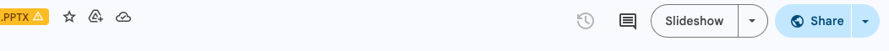
The Art of Woodworking Instruction
This course is designed for you, our woodworking instructors. Our intent with this course is to provide you with the tools needed to maintain a consistently high level of instruction for all our students.
This is a self study course. To begin, you will need to:
Gather a pen/pencil/digital tool to write with
Click “Slideshow” at the top right of your screen
Click on the screen to progress through the course

Slide 2

The Art of
Woodworking Instruction

Slide 3

Learning Objectives
Identify teaching methods that hinder hands on learning.
Identify teaching methods that enhance hands on learning.
Develop a personal Action Plan for improving instructional techniques.
Identify SDFWA teaching
policies/procedures

Slide 4

Welcome
Think about your own time as a learner—
  Who were your best teachers?
  What made them the best teachers?
  What did they do that enhanced your
  learning experience?
Notes:
Notes as examples needed here.

Slide 5
Does Your List Look Like This?
Good
Poor
Set clear goals
Provided step by step instruction
Used easy to understand language
Solicited questions
Checked your understanding
Used time efficiently
Mumbled their speech
Went off topic easily
Talked too much
Used too many slides
Used unreadable slides
Attempted to cover too much content / Ran out of time

Slide 6
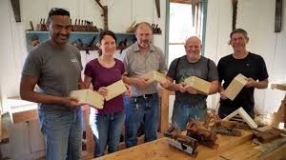
I would like to …
Reflect on your teaching:
  What do you already do well?
  What would you like to improve?
We will come back to this self assessment throughout this course.

Slide 7

Core Instructional Methods
Lecture (student listens)
Demonstration (student watches)
Skills Practice (student does)
Consider your own teaching
  Do you use these methods?
  Which do you think has the biggest impact?
  Let’s find out….
Notes:
In this course we will examine these core instructional methods

Slide 8
The Retention Pyramid
Passive
Reading
Hearing words
Watching a demo
Looking at an exhibit
Engage in dialog
Giving a talk
Simulating the experience
Doing the real thing
zzz
Sleep
Lecture
Demonstration
Skills Practice
Active
Notes:
Another way to understand how this works is by looking at the Retention Pyramid.
Top of this pyramid shows activities that provide LESS retention, moving down the activities provide MORE retention

Slide 9

Self Assessment
Think about your teaching methods.
What percentage of time do you allow for lecture, demonstrations, and skills practice?
This course will help you:
Build the skills needed to apply these methods to ensure the best learning experience for your students!
Notes:
Use this here or after covering these items?
Can you restructure your class to prioritize in this order:
Skills Practice
Demonstration
Lecture

Slide 10


But first…Preparation
Identify your course learning objectives
Gather (or create) materials that will
support student learning
  Visual aides
  Step-by-step instructions at the right
  level of detail
  Self-learning resources/videos
  Give pre-work if appropriate

Slide 11
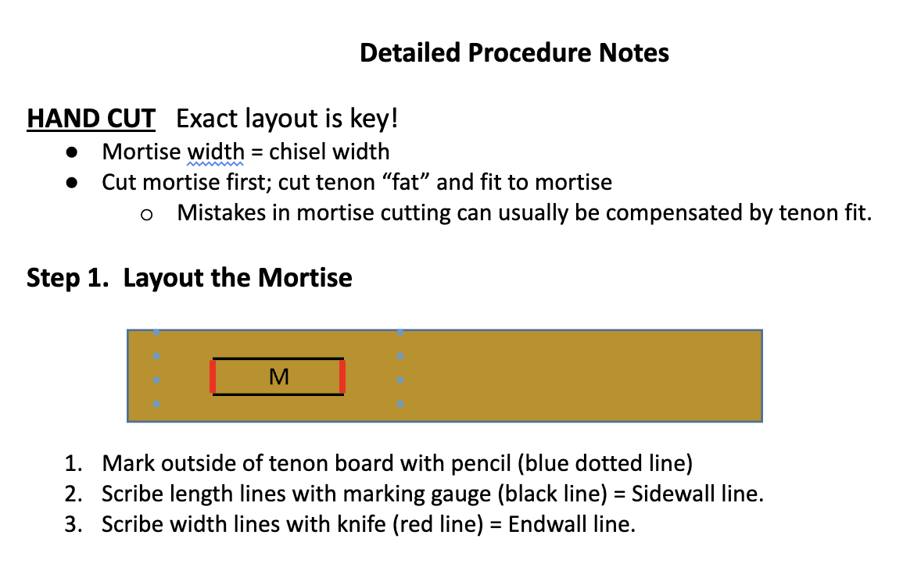
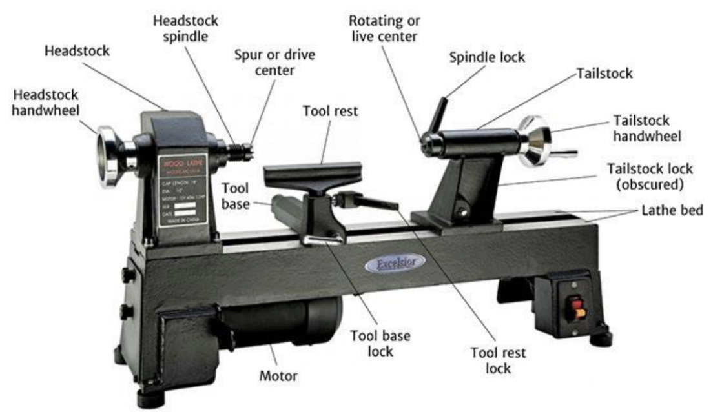
Student resource examples
Handouts
  Concise
Online Videos
Diagrams
  Clearly marked

Slide 12
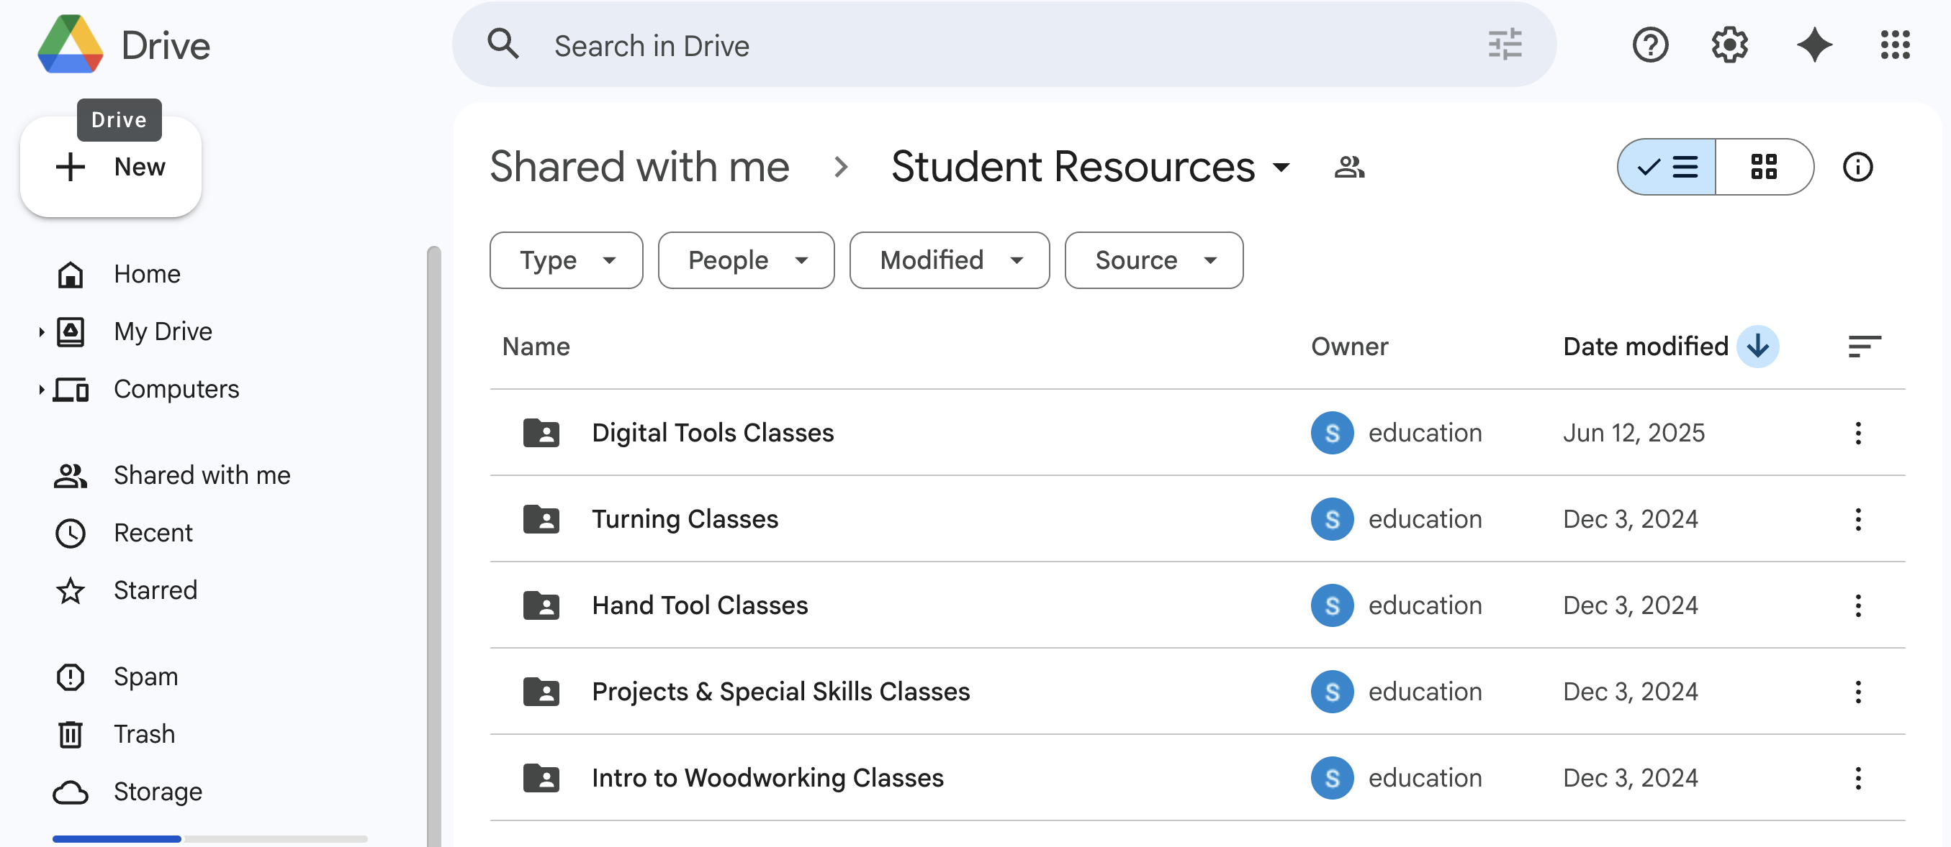
SDFWA Resource Center on Google Drive
The home for your teaching materials
Post your materials on the SDFWA Resource Center under your class name.
Send students the link to the folder for your class (select your class folder on Google Drive, then copy the link in the address bar).

Slide 13
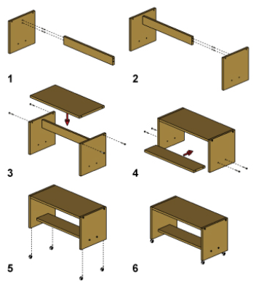
Preparation: Self Assessment
Have you prepared handouts?
  How do students access them?
  Are they concise, step by step?
Is there course pre-work? Should there be?
Are there good teaching videos that can prepare the students for your course or serve to enhance learning after the course?

Slide 14

Lecture
Think of a lecture as theater—the best lecturers use these skills
  Ice breaker-”what do you hope to learn today”
  Clear speech: diction and speed
  Movement and energy
  Humor
  Engages learners
    Create a dialog
    Ask questions
    Ask about student experience/opinions
Stay focused on content; avoid too many
personal stories

Slide 15

If You Must Use Slides …
Brief content per slide—must be readable
Elaborate on the slide content - don’t just read slides
Be careful with colors (don’t distract from the message)
Use graphics plus text
Pro tip:
Review one of the many YouTube videos on PowerPoint do’s/don’t’s.

Slide 16

How to speak so people listen
Take a few minutes and watch one of these Ted Talk videos
  https://www.youtube.com/watch?v=FHIo77y12gA
  https://www.youtube.com/watch?v=yoD8RMq2OkU

Slide 17
Lecture: Self Assessment
How do you welcome your students?
Are you a fast, medium or slow-paced speaker? Can you vary this?
Do you use your body, hands, movement to elaborate as you talk?
Do you use humor?
What percentage of class time are you lecturing?
  How much of your lecture time is core content vs. personal story-telling

Slide 18


Demonstrations
Give an overview first, identify the end goal
Present the task in small, discrete steps
Check for understanding along the way
The best teachers know/discuss common student errors (due to mis-marking, tool handling, body position, etc.)
Summarize what you have done

Slide 19
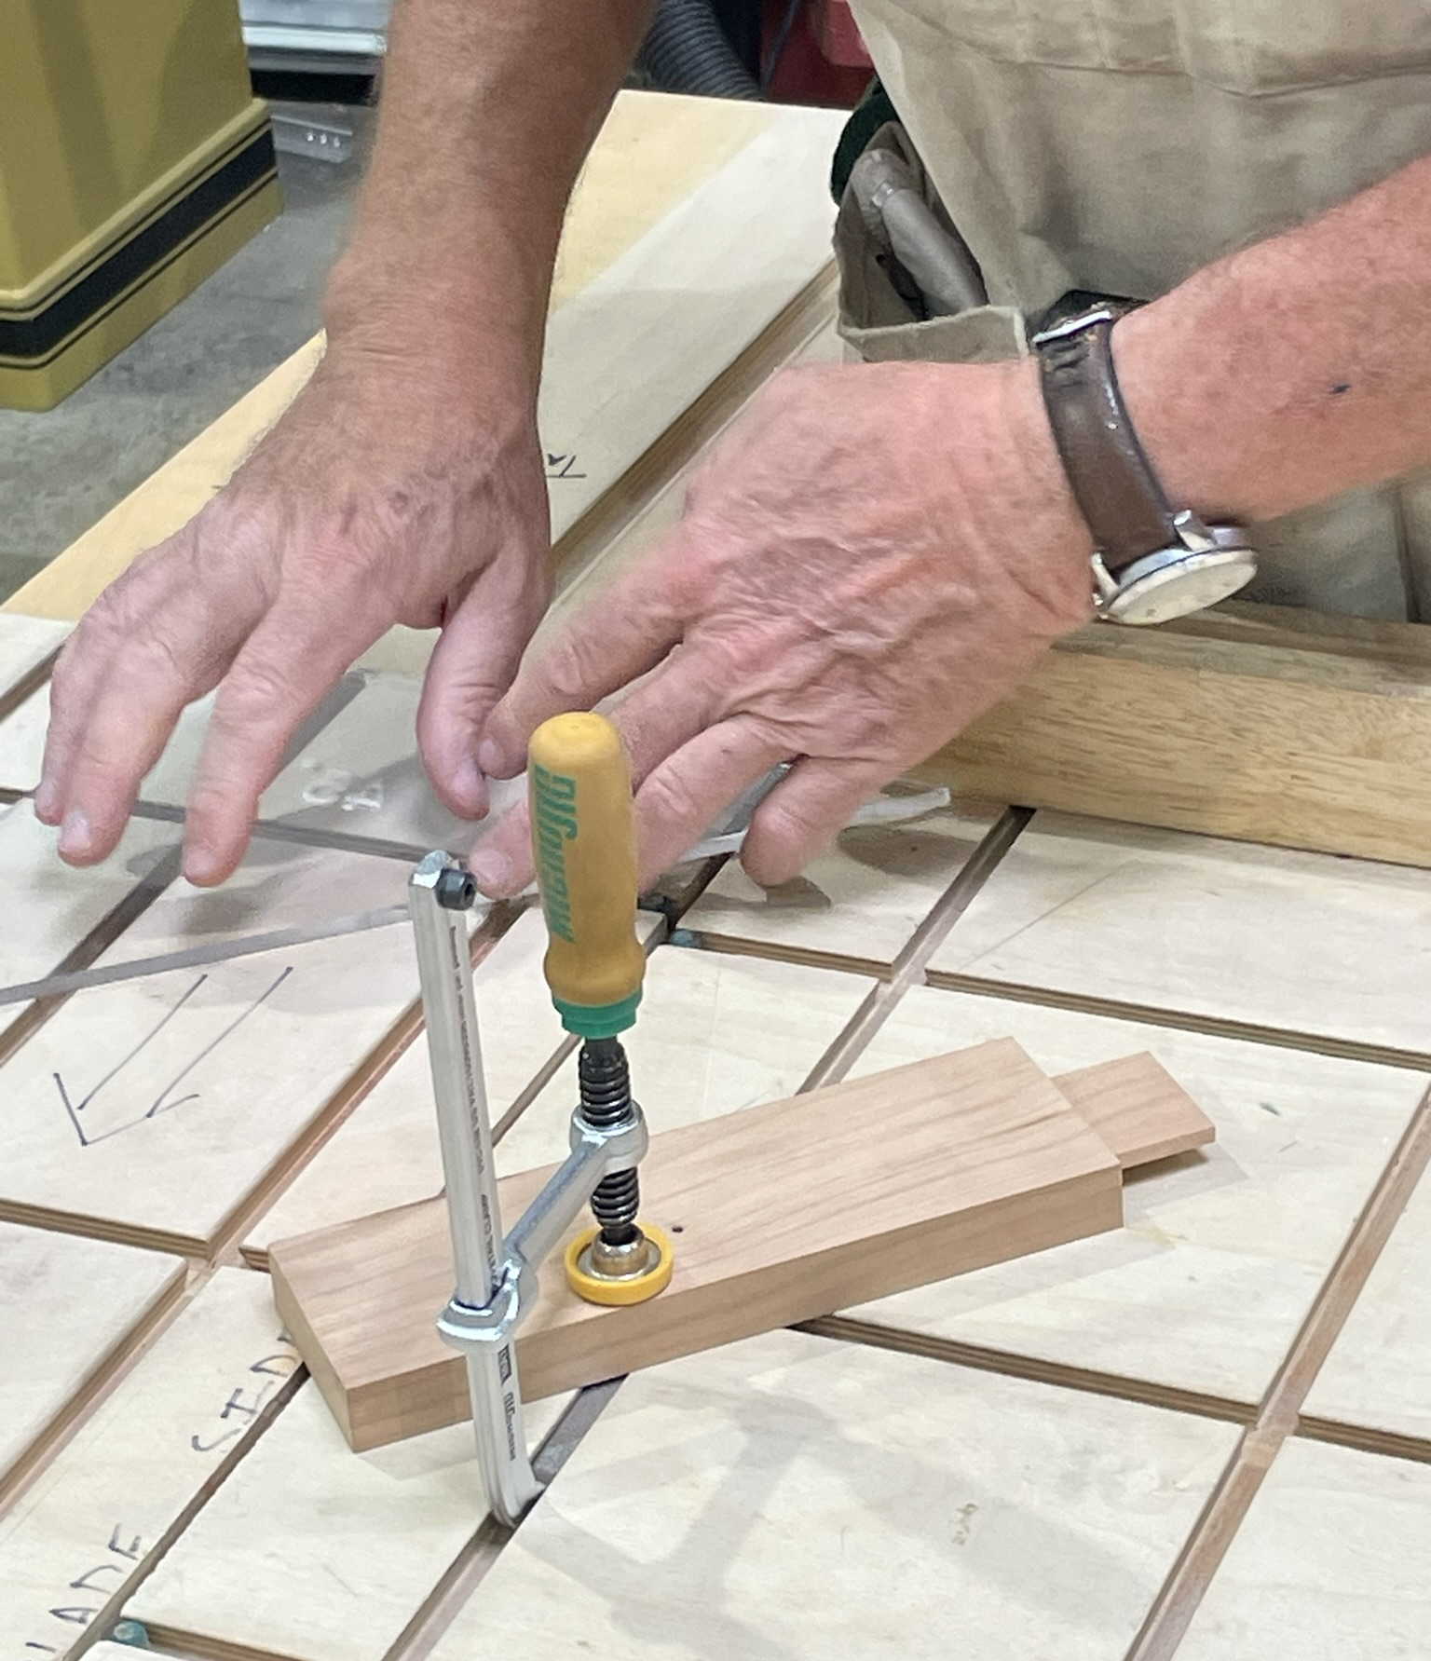
Demonstrations: Self Assessment
Do students know the end goal before you start your demonstration?
How often do you check for understanding during a demonstration?
Do you identify the common errors?
Is your demonstration time efficient?
How can you improve your demonstrations?

Slide 20

Skills Practice
Maximize time for hands-on activity
During hands-on activity
  Observe students
  Ask how they are doing
  Be ready to coach the student vs
  doing it for them
  Identify areas for positive feedback
  and provide it
  Demonstrate corrective actions
  where needed
Pro Tip:
Watch this video on giving feedback. https://www.youtube.com/watch?v=wtl5UrrgU8c

Slide 21
Skills Practice: Self Assessment
Are you maximizing time for skills practice?
Are you checking in with students during practice times?
Are you providing positive feedback?
Are you providing corrective demonstrations when needed?
Are you finding common problems that could benefit from a different teaching approach?
Is the allotted time sufficient for student practice and understanding?

Slide 22
Quick Quiz (part 1)
Instructions: Write down your answer to the question, then click on the screen to reveal the answer. Repeat for each question.
What types of activities result in the most retention?
The more active a student is (doing, dialog) the more they will _________.
What are 3 types of resources you can provide to students?
Where can you find and store student resources?
Hands on activity, dialog
retain
Step-by-step instructions, visual aids, diagrams, videos
SDFWA Resource Center on Google Drive

Slide 23
Quick Quiz (part 2)
Instructions: Write down your answer to the question, then click on the screen to reveal the answer. Repeat for each question.
What are 3 things you can do to enliven your lectures?
What should you do at the start of your demonstration?
In addition to showing the steps during a demonstration, what else can you do to better prepare the student?
When observing students doing a task be ready to ________ instead of _____________.
Which instructional method should you minimize during your classes?
Use humor, body movements, ice breakers, add energy
Provide an overview
Note common mistakes, proper body position, check for understanding
coach
doing the task
Lectures

Slide 24

Your Action Plan
To improve your facilitation skills, take a few minutes to write your answers to these questions:
What do you already do well?
What behaviors can you do less of?
What behaviors can you do more of?
What is something new that you can bring
to your teaching?
What do you want to do differently?
What resources do you need for success?
Make an Action Plan to be prepared for your next class!!

Slide 25
Your Action Plan (example)
Item #1: Prepare class handout
  Action Steps:
    Prepare step-by step list
    Pilot test the handout with next class
    Upload handout to SDFWA Resource Center
Item #2: Improve my feedback skills
  Action Steps:
    Watch a You Tube Video (e.g. Ted Talk on Feedback)
    Try newly learned skills with next class-ask students for feedback.

Slide 26
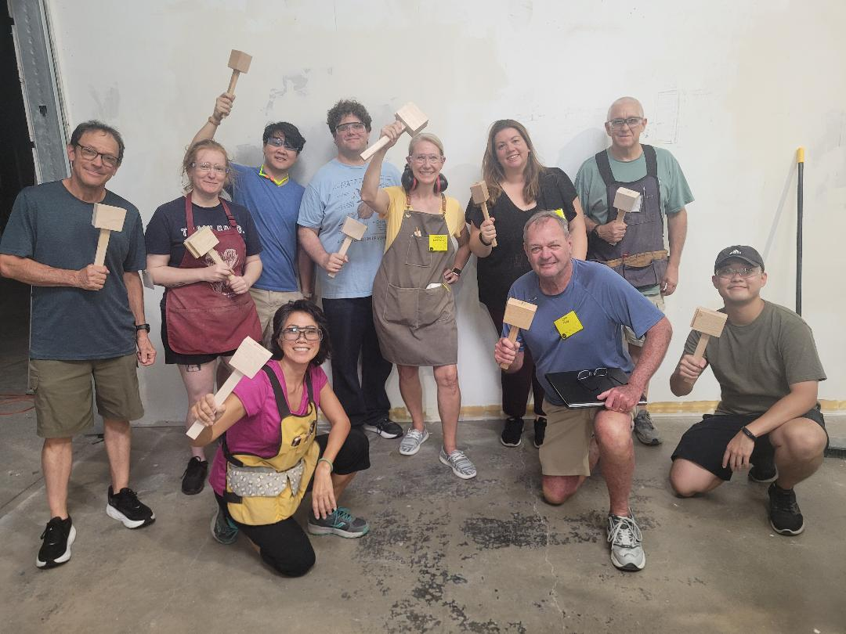
Administration
SDFWA Education Committee
Class Scheduling
Policies

Slide 27
SDFWA Education Committee
Members
Nels Lundgren, Director
David Weissman, Associate Director
Scott Sypkens, Scheduling
Ben Green, Registrar
Wendy Pollock, Evaluations
Mark Warmbrand, Resources, Scholarships
Karen Gersoft, Associate Registrar
Diana Ram, Communications
Responsibilities
  New course approval
  Scheduling
  Registrations/Payment
  Evaluations
  Policies
  Scholarships
  Supplies

Slide 28

Class Scheduling
Quarterly (July 1, Oct 1, Jan 1, April 1)
For each quarter, all classes are open for registration one month prior at 8 am. (ex. Spring quarter is posted on March 1).
Waiting lists are maintained by registrar; openings are filled from wait list.
  Notify registrar immediately if student contacts you to drop.
  Contact Nels Lundgren if you need to move a class.

Slide 29

Policies
Age: 18 or older to attend a class
Must be SDFWA member
Shop Membership is not required for any class
Refund policy:
  Less than 7 days: No refund
  7-14 days: 50%
  >14 days: 100%
Classes with poor enrollment may be cancelled—you will be contacted ahead of time

Slide 30
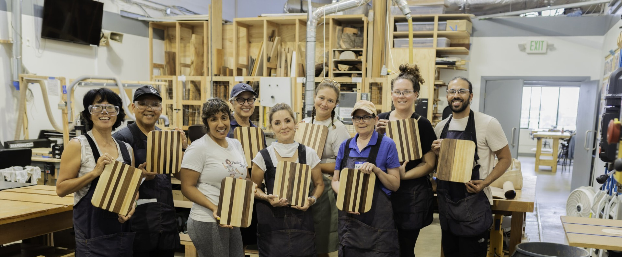
Congratulations on completing this self-study course and taking the time to improve your skills as an instructor!

